Slide 1
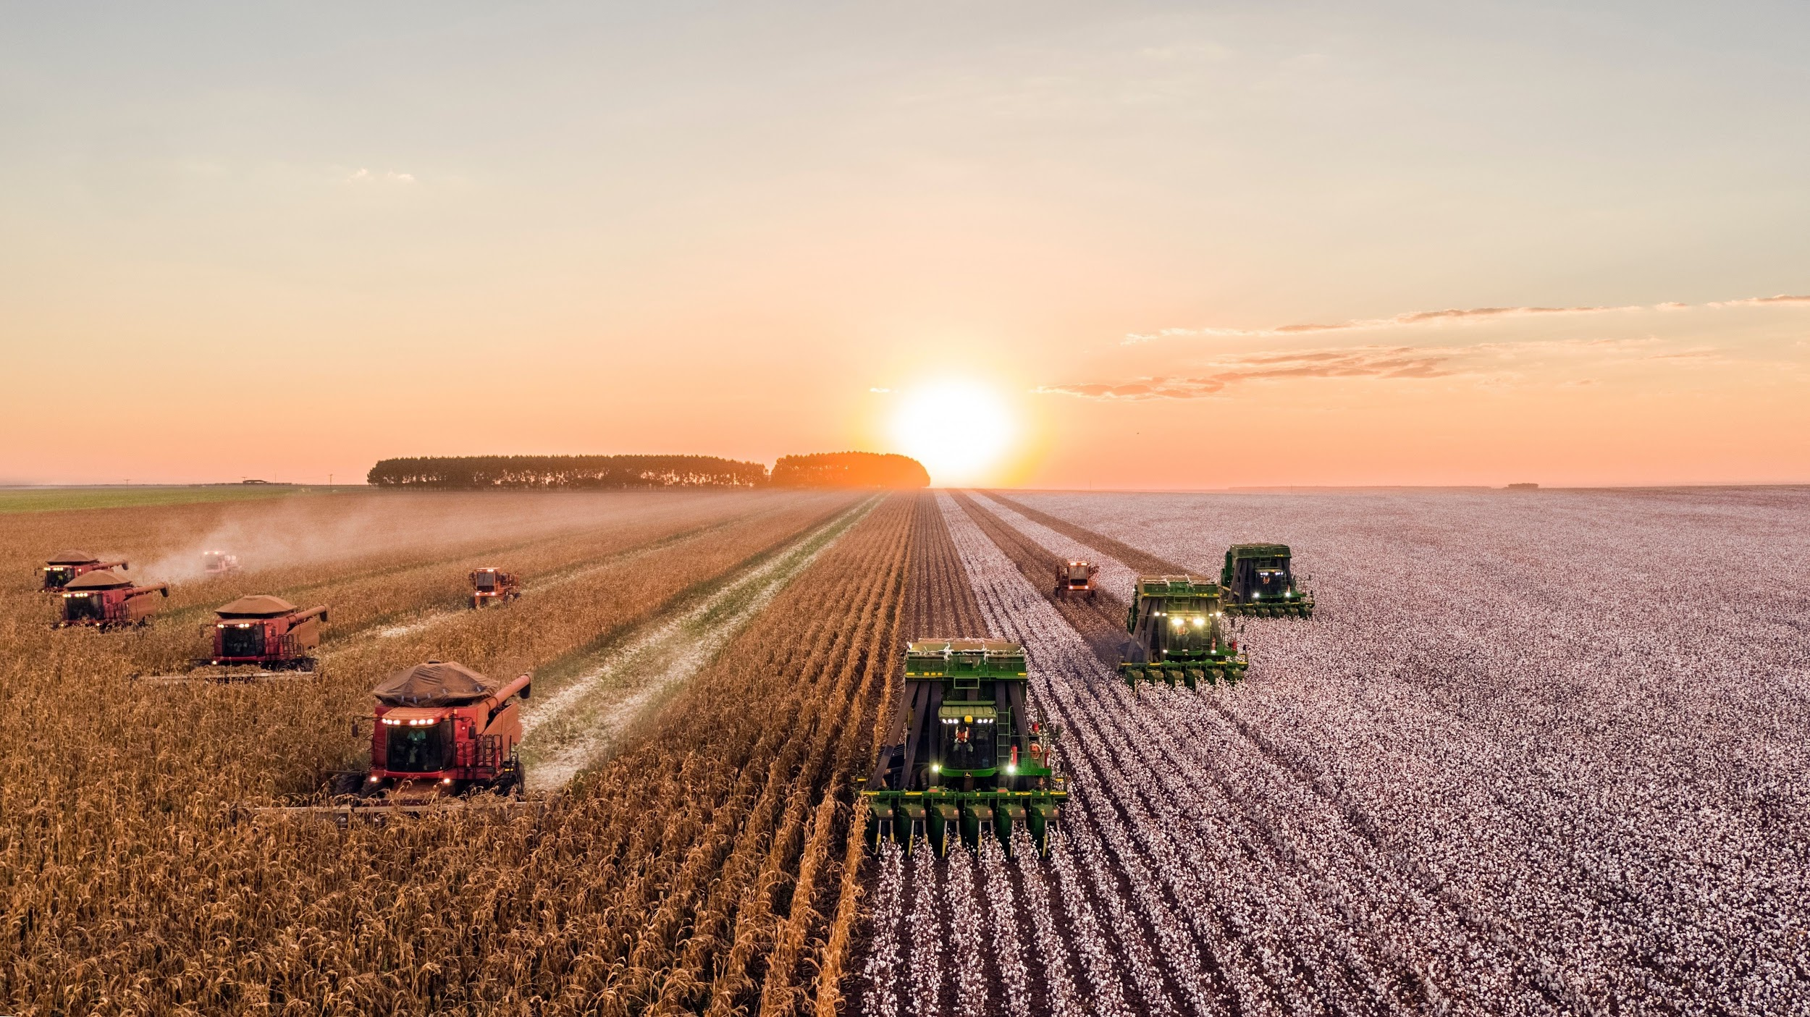
Climate change in our countries: agriculture
Group B

Slide 2
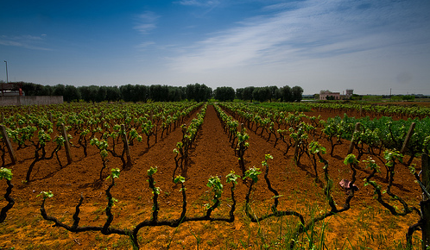
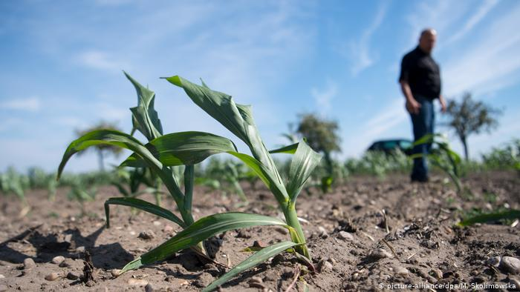
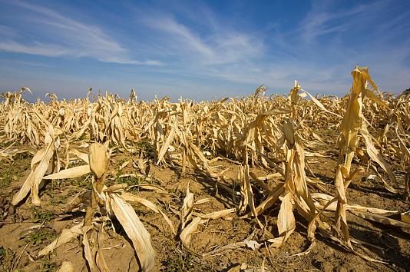
Italy
Italy is strongly affected by the negative consequences of climate changes. In the last twenty years, a growing number of extreme weather events occurred and a rising shortage of water in several areas, traditionally suited to agriculture activities, in particular, in some areas of South of Italy.

Slide 3
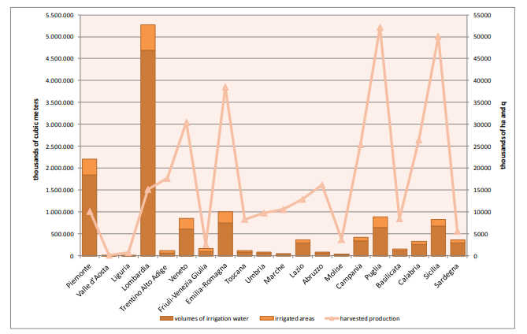

Slide 4
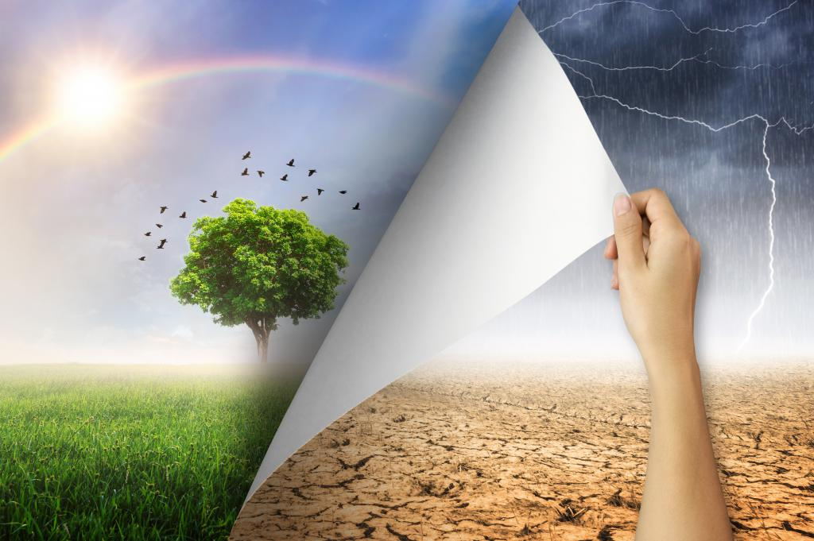
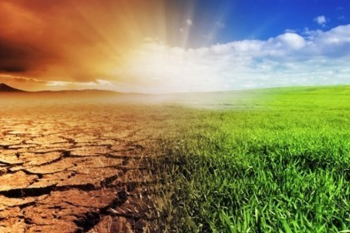
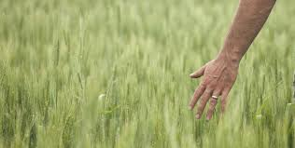
Sweden
Our trees need the right temperature and rain to grow. Our economy is pretty much based on our trees so it's very important.

